Slide 1

STEVE’S CAR SHOWROOM
SQL CHALLENGE
JYOTI MANOJ MANDAL | DATA ANALYST
17/06/2023

Slide 2

INTRODUCTION
Steve runs a top-end car showroom but his data analyst has just quit and left him without his crucial insights. Here I can Analyze the following data to provide him with all the answers he requires.

Slide 3
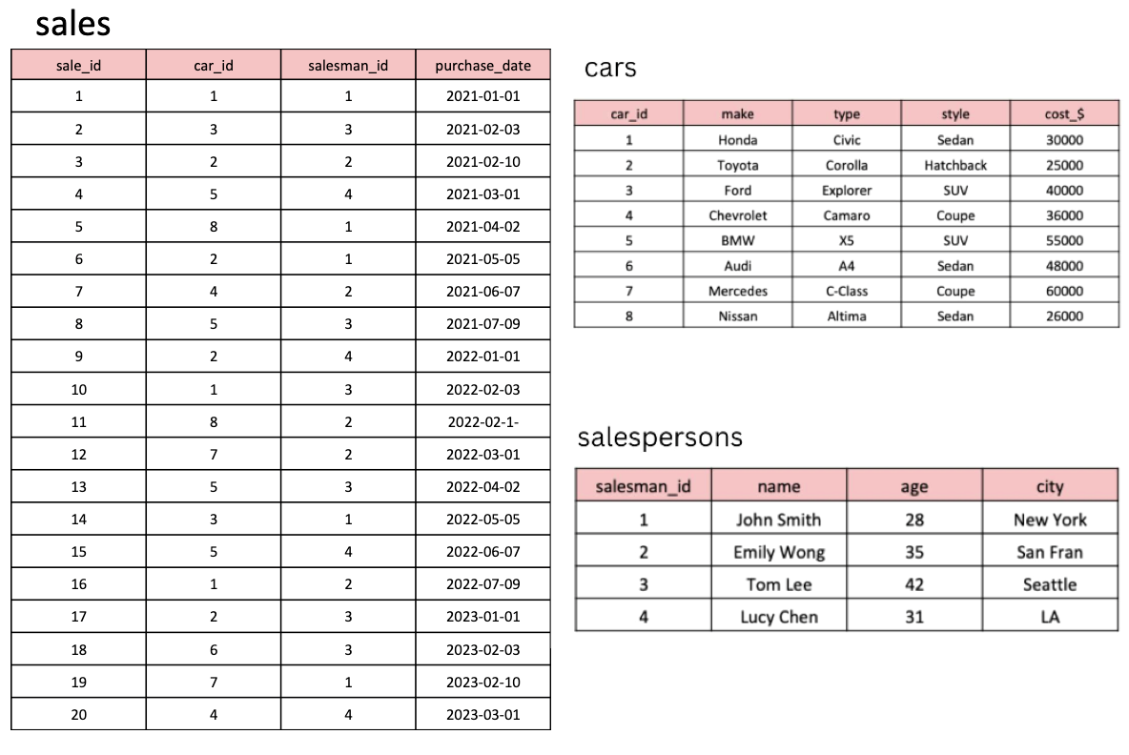
TABLES Here are the tables I will be using:

Slide 4
The Following CODE into the “Schema SQL” section to create above tables:
CREATE TABLE cars ( car_id INT PRIMARY KEY, make VARCHAR(50), type VARCHAR(50), style VARCHAR(50), cost_$ INT ); INSERT INTO cars (car_id, make, type, style, cost_$) VALUES (1, 'Honda', 'Civic', 'Sedan', 30000), (2, 'Toyota', 'Corolla', 'Hatchback', 25000), (3, 'Ford', 'Explorer', 'SUV', 40000), (4, 'Chevrolet', 'Camaro', 'Coupe', 36000), (5, 'BMW', 'X5', 'SUV', 55000), (6, 'Audi', 'A4', 'Sedan', 48000), (7, 'Mercedes', 'C-Class', 'Coupe', 60000), (8, 'Nissan', 'Altima', 'Sedan', 26000);
CREATE TABLE salespersons ( salesman_id INT PRIMARY KEY, name VARCHAR(50), age INT, city VARCHAR(50) ); INSERT INTO salespersons (salesman_id, name, age, city) VALUES (1, 'John Smith', 28, 'New York'), (2, 'Emily Wong', 35, 'San Fran'), (3, 'Tom Lee', 42, 'Seattle'), (4, 'Lucy Chen', 31, 'LA'); --------------------
CREATE TABLE sales ( sale_id INT PRIMARY KEY, car_id INT, salesman_id INT, purchase_date DATE, FOREIGN KEY (car_id) REFERENCES cars(car_id), FOREIGN KEY (salesman_id) REFERENCES salespersons(salesman_id) ); -------------------- INSERT INTO sales (sale_id, car_id, salesman_id, purchase_date) VALUES (1, 1, 1, '2021-01-01'), (2, 3, 3, '2021-02-03'), (3, 2, 2, '2021-02-10'), (4, 5, 4, '2021-03-01'), (5, 8, 1, '2021-04-02'), (6, 2, 1, '2021-05-05'), (7, 4, 2, '2021-06-07'), (8, 5, 3, '2021-07-09'), (9, 2, 4, '2022-01-01'), (10, 1, 3, '2022-02-03'), (11, 8, 2, '2022-02-10'), (12, 7, 2, '2022-03-01'), (13, 5, 3, '2022-04-02'), (14, 3, 1, '2022-05-05'), (15, 5, 4, '2022-06-07'), (16, 1, 2, '2022-07-09'), (17, 2, 3, '2023-01-01'), (18, 6, 3, '2023-02-03'), (19, 7, 1, '2023-02-10'), (20, 4, 4, '2023-03-01');

Slide 5
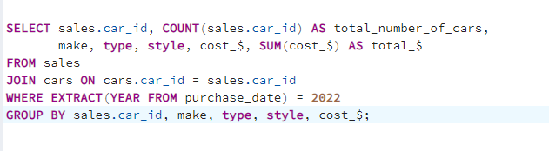
1. WHAT ARE THE DETAILS OF ALL CARS PURCHASED IN THE YEAR 2022?

Slide 6
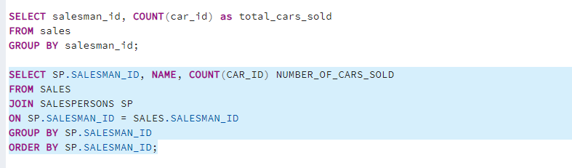
2. WHAT IS THE TOTAL NUMBER OF CARS SOLD BY EACH SALESPERSON?

Slide 7
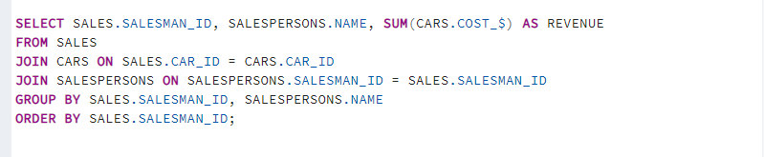
3. WHAT IS THE TOTAL REVENUE GENERATED BY EACH SALESPERSON?

Slide 8
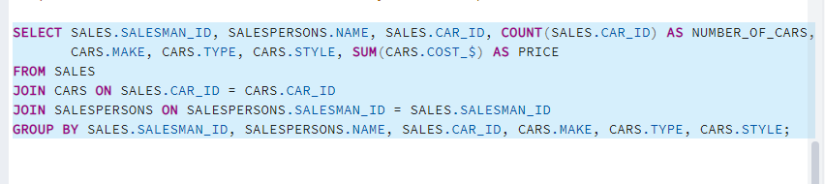
4. WHAT ARE THE DETAILS OF THE CARS SOLD BY EACH SALESPERSON?

Slide 9
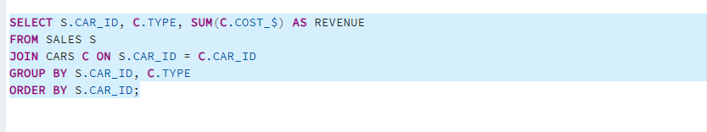
5. WHAT IS THE TOTAL REVENUE GENERATED BY EACH CAR TYPE?

Slide 10
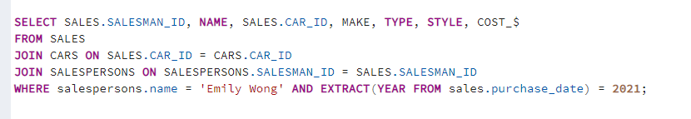
6. WHAT ARE THE DETAILS OF THE CARS SOLD IN THE YEAR 2021 BY SALESPERSON 'EMILY WONG'?

Slide 11
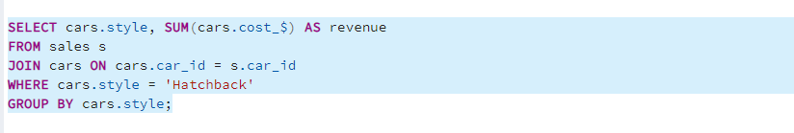
7. WHAT IS THE TOTAL REVENUE GENERATED BY THE SALES OF HATCHBACK CARS?

Slide 12
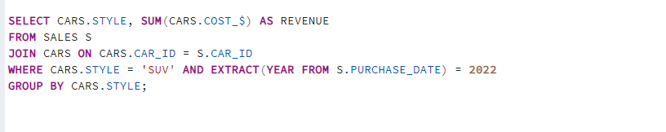
8. WHAT IS THE TOTAL REVENUE GENERATED BY THE SALES OF SUV CARS IN THE YEAR 2022?

Slide 13
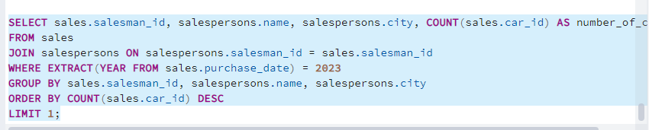
9. WHAT IS THE NAME AND CITY OF THE SALESPERSON WHO SOLD THE MOST NUMBER OF CARS IN THE YEAR 2023?

Slide 14
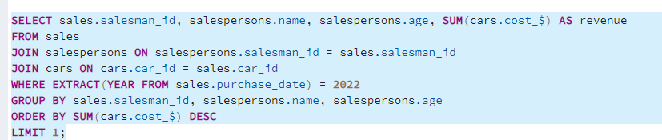
10. WHAT IS THE NAME AND AGE OF THE SALESPERSON WHO GENERATED THE HIGHEST REVENUE IN THE YEAR 2022?

Slide 15
RESULTS
In 2022 the most number of purchased cars were from Honda (2) and BMW (2), the highest revenue was made by BMW (110000$).
Tom Lee sold the most number of cars (6) and the highest total revenue (1920000$) was generated by him as well.
The highest total revenue was generated by Car Type X5 (220000$).
Emily Wong sold a Toyota (25000$) and a Chevrolet (36000$) in 2021.
Hatchback Style Cars generated 100000$ Revenue.
SUV Style Cars generated 150000$ Revenue in 2022.
In 2023 the most number of cars were sold by Tom Lee (2) in Seattle.
In 2022 the highest revenue (116000$) was generated by Emily (age: 35).

Slide 16



